Slide 1
Recursion and Lambda Function

Slide 2
Recursion
Recursion is usually used in function definition.
If a function calls itself, it is recursive.
It is a control structure equivalent to a loop.
Anythink that is written recursively ca be non-recursively and vice versa.

Slide 3
Example for recursion
The factorial of a positive integer n, denoted as n!, is defined as follows:
In other words, n! is the product of all integers from 1 to n, inclusive.

Slide 4

Factorial so lends itself to recursive definition that programming texts nearly always include it as one of the first examples. You can express the definition of n! recursively like this:

Slide 5
As with the example shown above, there are base cases that are solvable without recursion.
The more complicated cases are reductive, meaning that they reduce to one of the base cases:
The base cases (n = 0 or n = 1) are solvable without recursion.

Slide 6
For values of n greater than 1, n! is defined in terms of (n - 1)!, so the recursive solution progressively approaches the base case.
The base cases (n = 0 or n = 1) are solvable without recursion.
For values of n greater than 1, n! is defined in terms of (n - 1)!, so the recursive solution progressively approaches the base case.

Slide 7
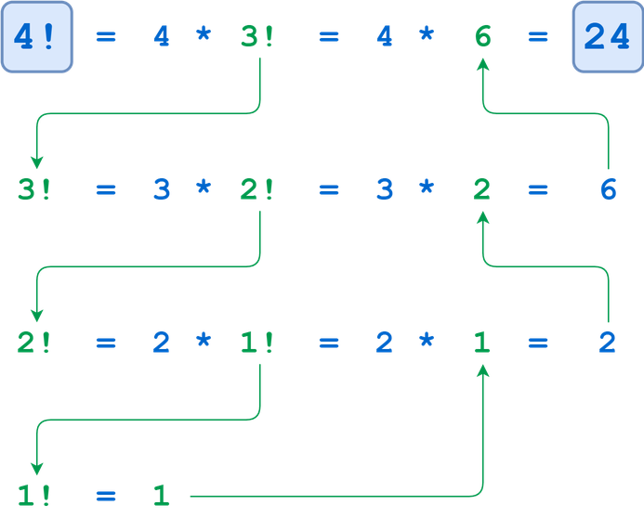

Slide 8
Example
# Factorial of a number using recursion
def factorial(n):
if(n <= 1):
return 1
else: return(n*factorial(n-1))
n = int(input("Enter number:"))
print("Factorial:")
print(factorial(n))
Output:
Enter number:3
Factorial:
6

Slide 9
Program Explanation
1. User must enter a number and store it in a variable.
2. The number is passed as an argument to a recursive factorial function.
3. The base condition is that the number has to be lesser than or equal to 1 and return 1 if it is.
4. Otherwise the function is called recursively with the number minus 1 multiplied by the number itself.
5. The result is returned and the factorial of the number is printed.

Slide 10
Anonymous Functions
Python Lambda Functions are anonymous function means that the function is without a name.
As we already know that the def keyword is used to define a normal function in Python.
Similarly, the lambda keyword is used to define an anonymous function in Python.
This function can have any number of arguments but only one expression, which is evaluated and returned.

Slide 11
Python Lambda Function Syntax:
lambda arguments: expression
Example:
def cube(y):
return y*y*y Output: 125 125
lambda_cube = lambda y: y*y*y
print(cube(5))
print(lambda_cube(5))

Slide 12
Without using Lambda:
Here, both of them return the cube of a given number.
But, while using def, we needed to define a function with a name cube and needed to pass a value to it.
After execution, we also needed to return the result from where the function was called using the return keyword.
Using Lambda:
Lambda definition does not include a “return” statement, it always contains an expression that is returned.
We can also put a lambda definition anywhere a function is expected, and we don’t have to assign it to a variable at all.
This is the simplicity of lambda functions.

Slide 13
For More Understanding
tables = [lambda x=x: x*10 for x in range(1, 11)]
for table in tables:
print(table())
Output:
10
20
30
40
50
60
70
80
90
100

Slide 14
Lambda Function with if-else:
Max = lambda a, b : a if(a > b) else b
print(Max(1, 2))
Output:
2
Using lambda() Function with filter()
li = [5, 7, 22, 97, 54, 62, 77, 23, 73, 61]
final_list = list(filter(lambda x: (x%2 != 0) , li))
print(final_list)
Output:
[5, 7, 97, 77, 23, 73, 61]
ages = [13, 90, 17, 59, 21, 60, 5]
adults = list(filter(lambda age: age>18, ages))
print(adults)
Output:
[90, 59, 21, 60]

Slide 15
Example:
data = [[2,3,4],[1, 4, 16, 64],[3, 6, 9, 12]]
sort_elements = lambda x: (sorted(y) for y in x)
get_second_elements = lambda x, f : [y[1] for y in f(x)]
second_elements = get_second_elements(data, sort_elements)
print(second_elements)
Output:
[3, 4, 6]

